Slide 1
TR Switch and RF amplifier for 1.5mT
Padma C.R.
JRF, MIRC

Slide 2
CONTENTS
TR switch
9.5mT
1.5 T
RF amplifier for 1.5T

Slide 3
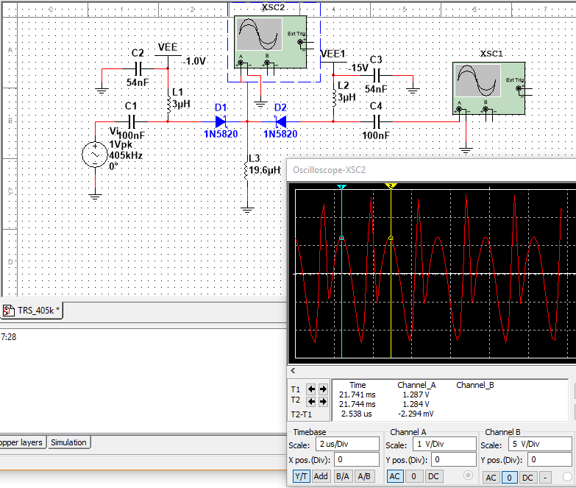
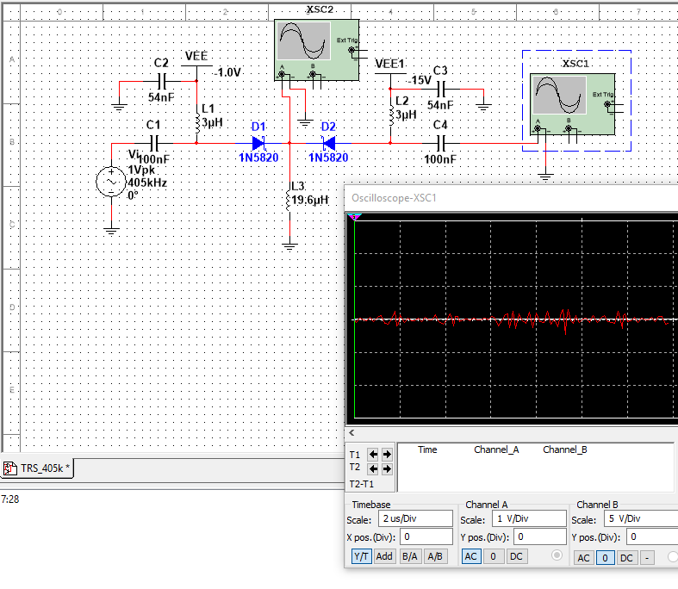
TR Switch for 9.5 mT

Slide 4
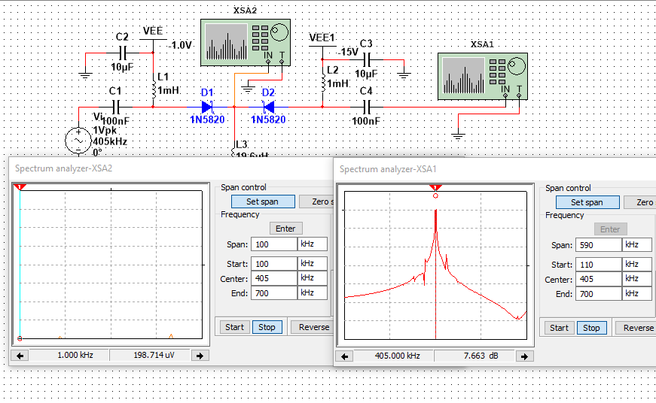
TR Switch for 9.5 mT
RECEIVE END
TRANSMIT END
RECEIVE END
TRANSMIT END

Slide 5
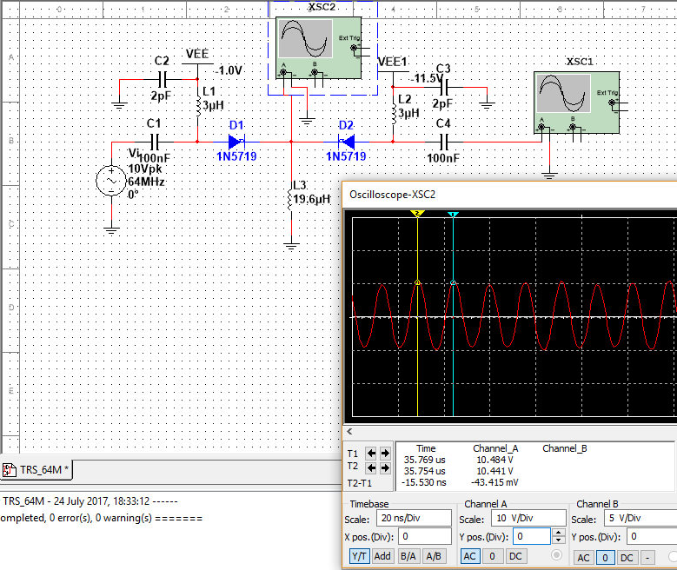
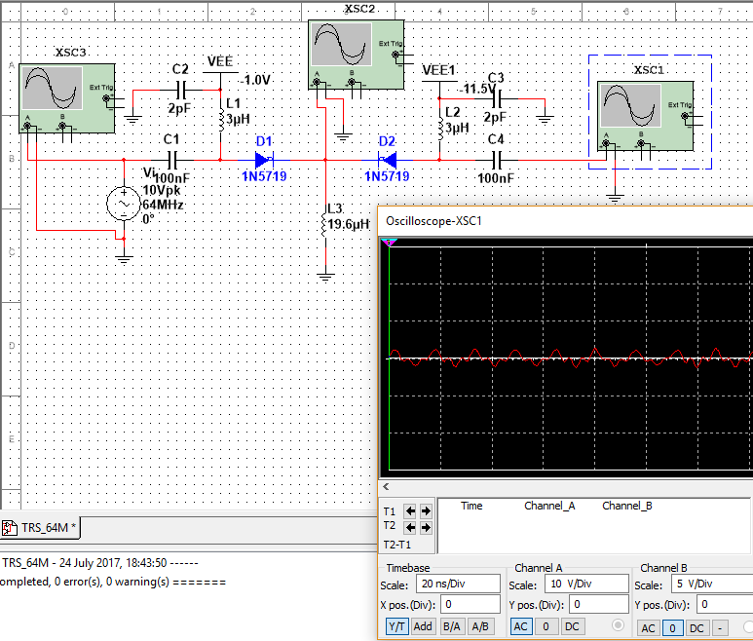
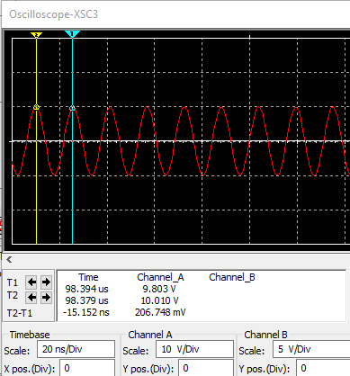
TR Switch for 1.5T
TRANSMIT END
RECEIVE END
INPUT

Slide 6
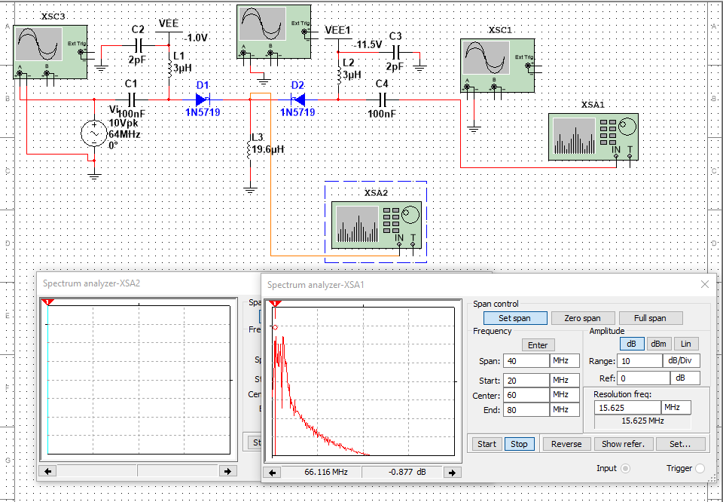
TR Switch for 1.5T

Slide 7
RF amplifier for 1.5T
CONSIDERATIONS IN RF POWER AMPLIFIER DESIGN
Stability
Impedance matching
Electro magnetic Interference
Stability: K > 1 and A > 0
K is the stability factor and A is the auxiliary stability factor
Impedance Matching : Lumped circuits/ distributed parameter circuits

Slide 8
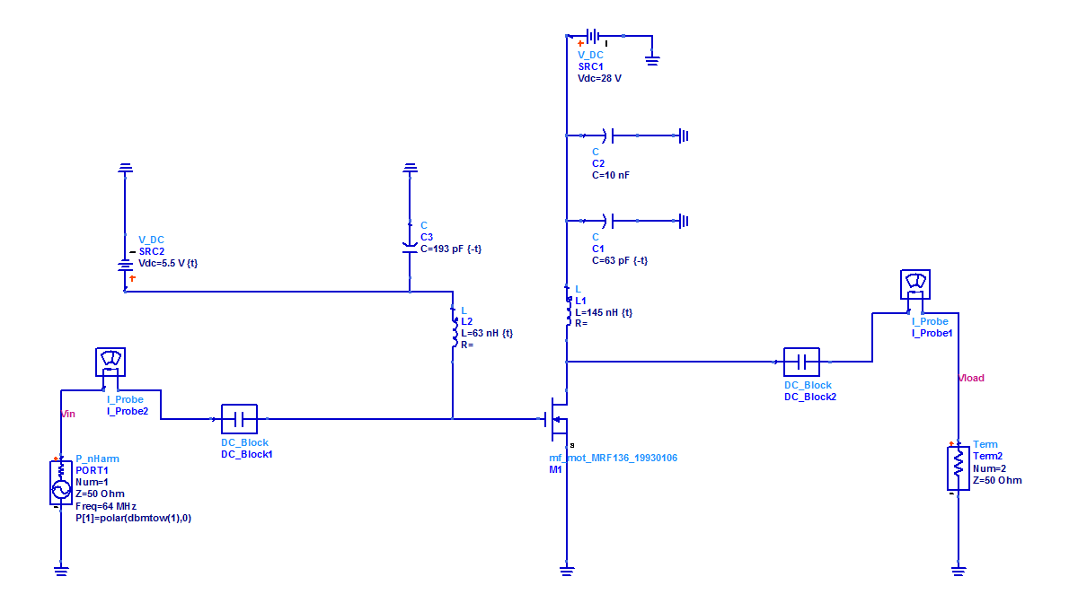
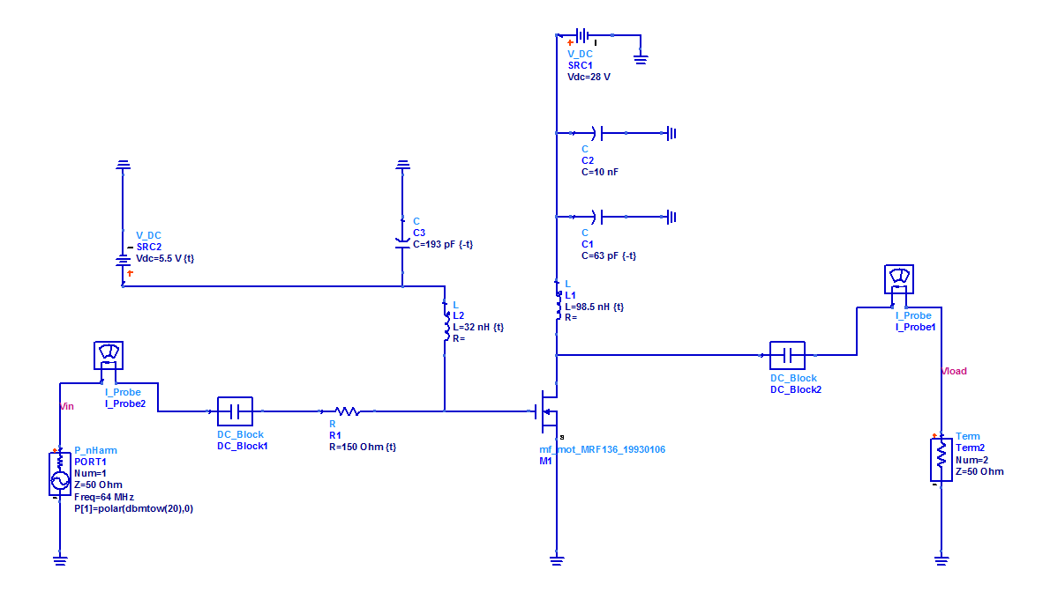
RF Amplifier first and second stage design
Amplifier first stage
Amplifier second stage

Slide 9
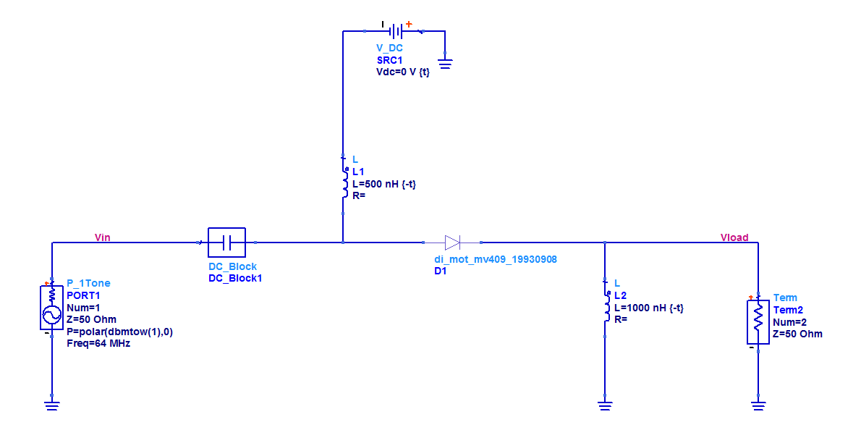
Automatic gain control (AGC)
The inductors L1 and L2 are tuned such that entire input power is transmitted to the output without any control voltage being applied to the diode.
The inductor L2 is used as an RF shunt to ground for any spurious currents at 64MHz.

Slide 10
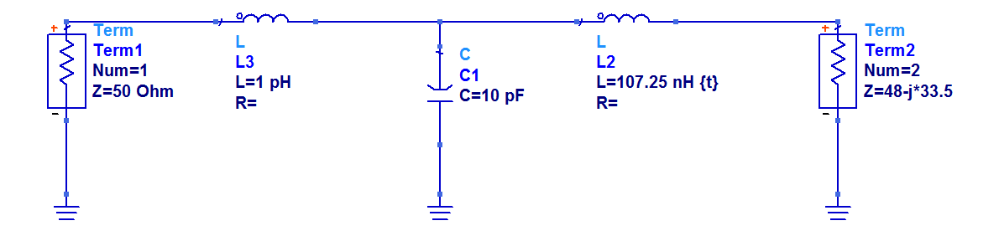
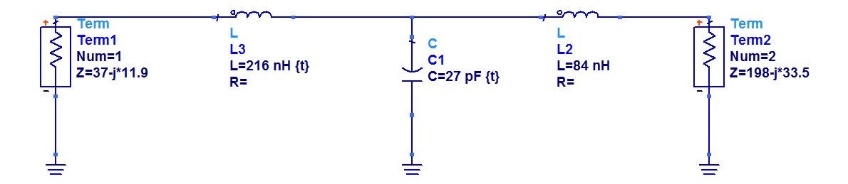
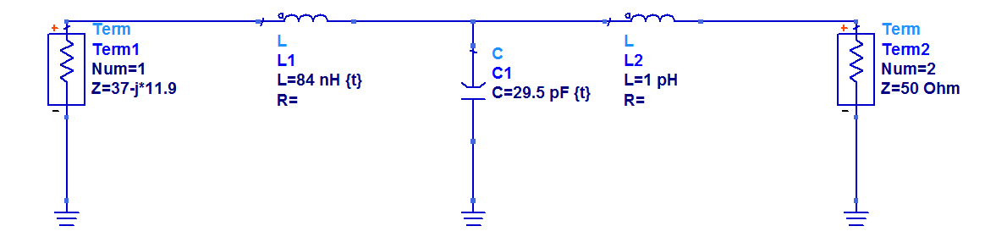
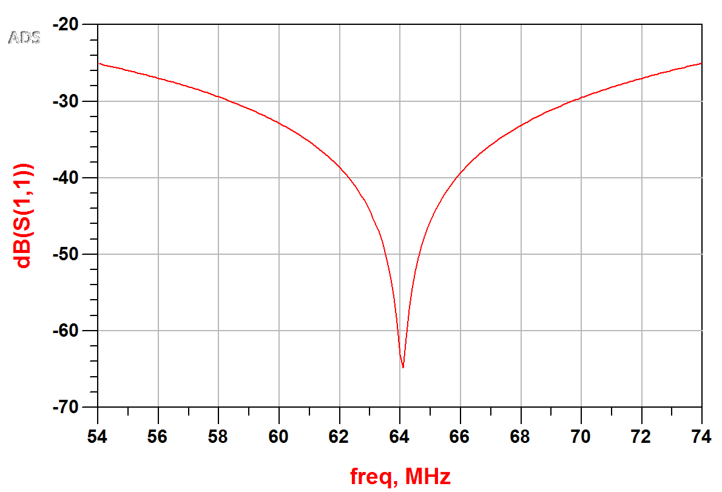
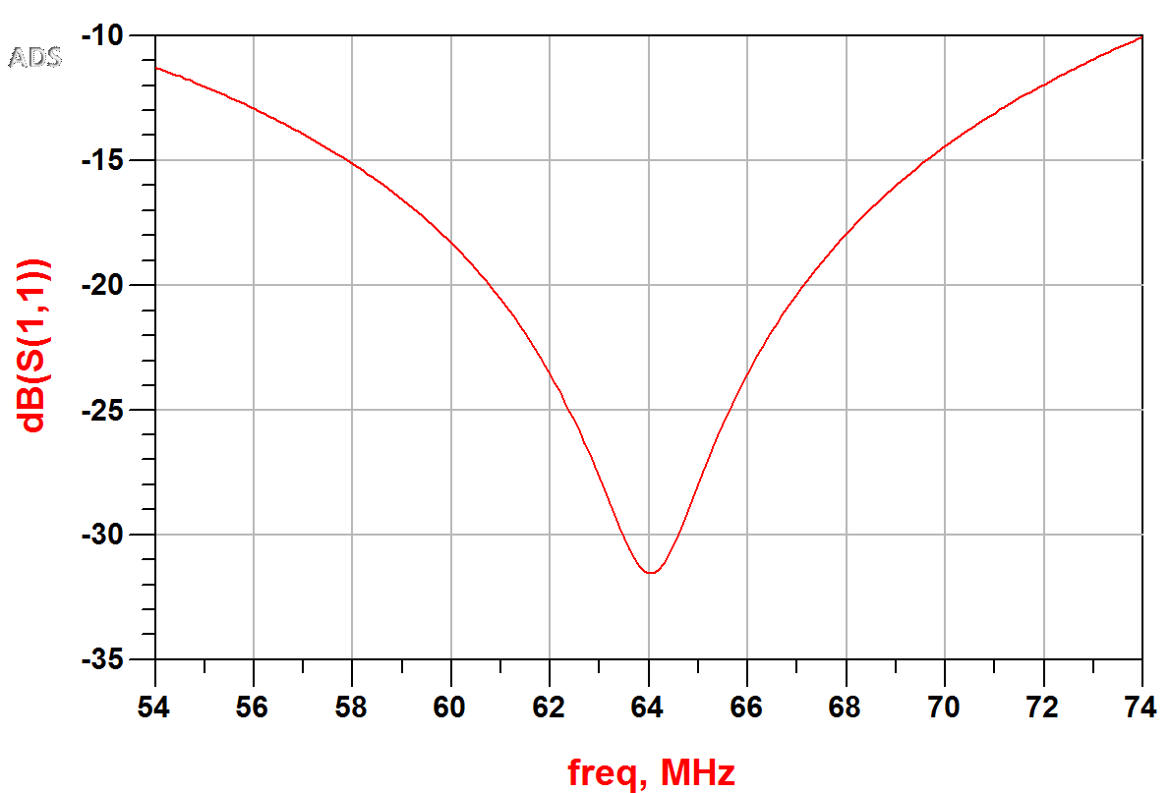
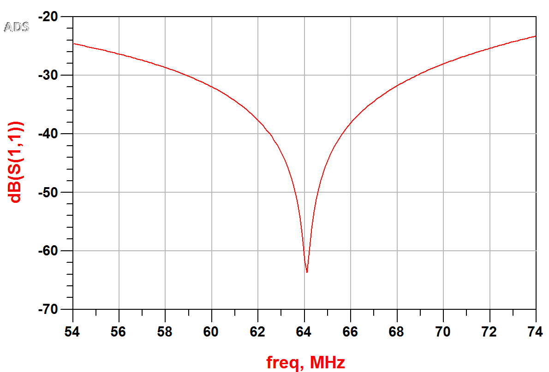
Matching networks
Matching network between input and first stage input side.
Matching network between first stage output and second stage input
Matching network between second stage output and load

Slide 11
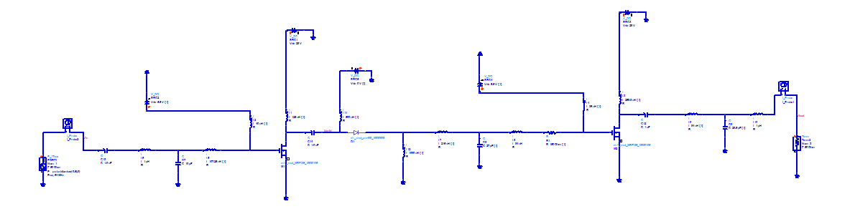
Complete RFA circuit
The complete two stage RFA circuit for 1.5T is as shown above. The only addition is the coupling capacitors included between stages so that there is no DC shift at the outptut.
The maximum output power of the RFA is 14.938W and the minimum power is 385mW. The detailed discussion of the RFA results is done in the results section.

Slide 12
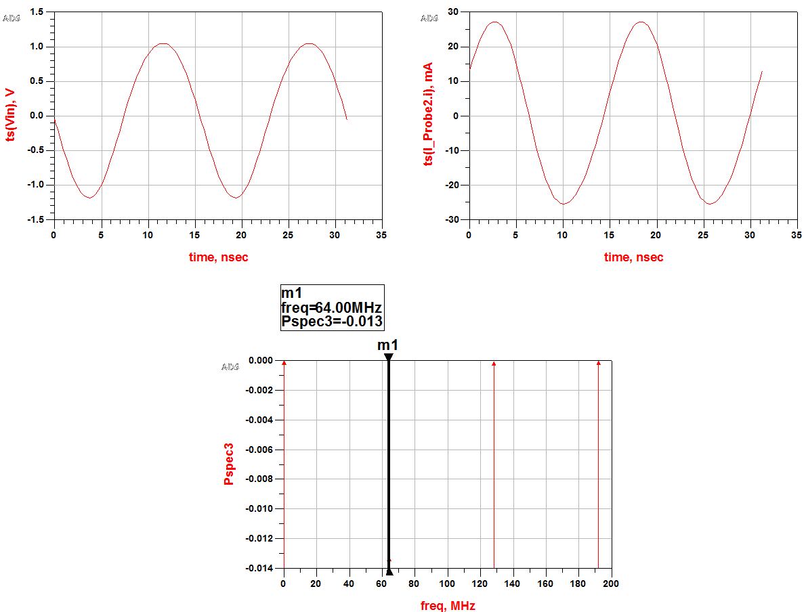
Results
First, the stage by stage results of the RFA without gain control will be discussed after which the effect of the gain control is shown.
Input voltage, current and power

Slide 13
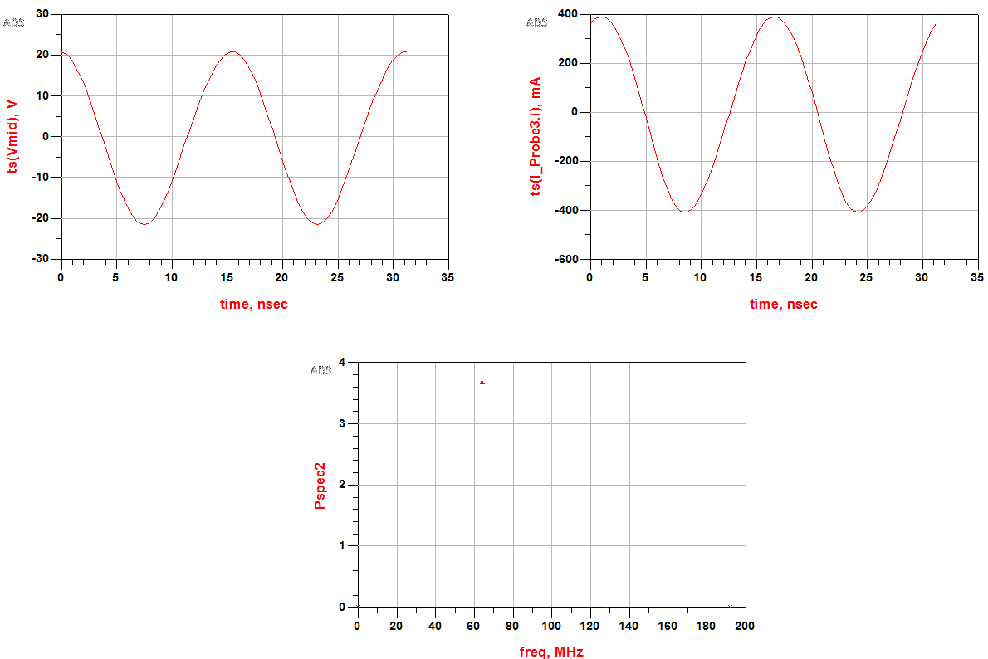
First stage output

Slide 14
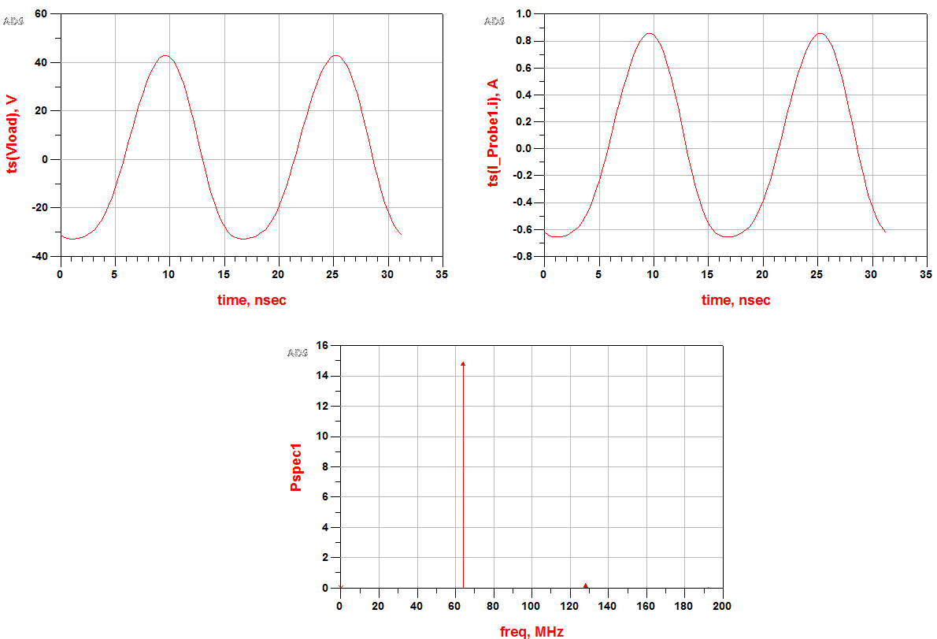
Second stage output

Slide 15
Tabulation of results
 | Voltage(p-p) |  | Current(p-p) |  | Power
 | V | dB | A | dB | W | dBm
Input | 2.23 | 0.991 | 0.052 | -31.5 | -0.013 | -0.5
First stage output | 42.2 | 26.429 | 0.797 | -8.023 | 3.7 | 35.69
Second stage output | 75.74 | 31.74 | 1.51 | -2.24 | 14.938 | 41.74
Note: negative sign in input power indicates that current leads voltage at the input by 180º.

Slide 16
Tabulation of results with AGC
AGC Voltage (V) | Power (W)
1 | 10.867
2 | 9.034
3 | 8.500
4 | 6.043
5 | 4.310
6 | 3.200
7 | 2.472
8 | 1.970
9 | 1.609
10 | 1.341
11 | 1.151
12 | 1.060
13 | 1.004
AGC Voltage (V) | Power (W)
14 | 0.886
15 | 0.774
16 | 0.684
17 | 0.611
18 | 0.551
19 | 0.499
20 | 0.456
21 | 0.418
22 | 0.385
Note: at AGC voltage V=0V, power=14.938W

Slide 17
Tabulation of results with pulsed input
 | Voltage(p-p) |  | Current(p-p) |  | Power
 | V | dB | A | dB | W | dBm
Input | 2.23 | 0.991 | 0.015 | -42.73 | -0.0024 | -6.2
First stage output | 9.962 | 13.902 | 0.164 | -21.96 | 0.196 | 22.92
Second stage output | 62.871 | 30.069 | 1.258 | -3.9 | 10.159 | 40.07
The variation in power occurs in case of pulsed input because while simulating the simulator considers the pulsed input source as a pure voltage source thereby giving only 15mA of current from the source to first stage of the RFA.

Slide 18
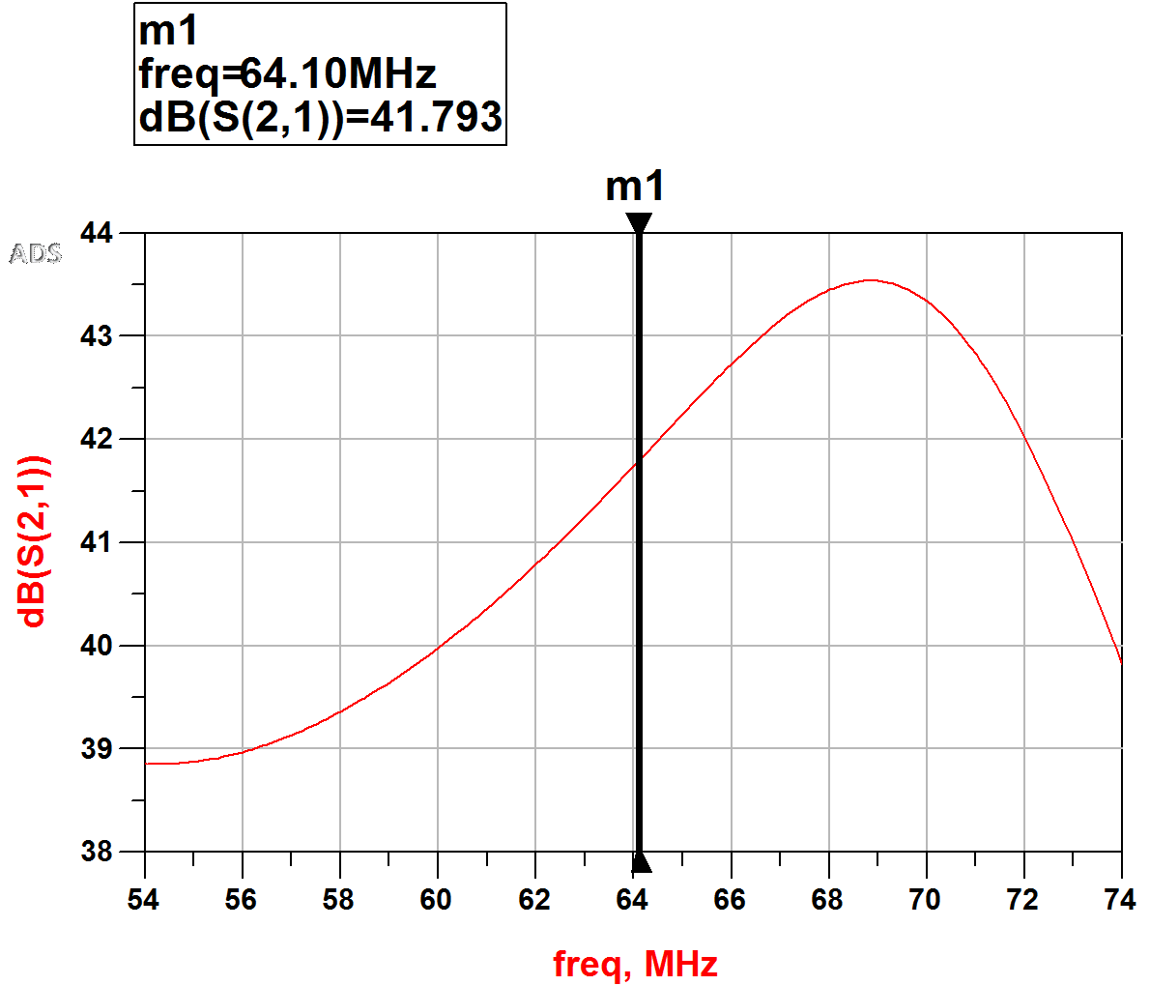
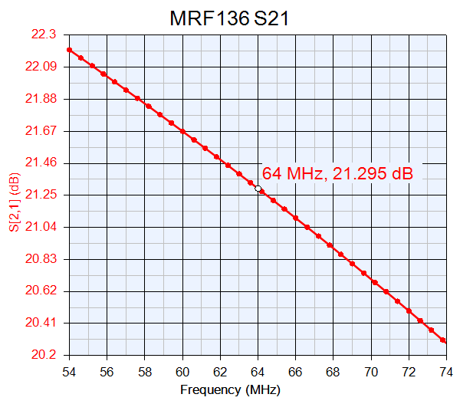
Overall gain of the RFA
The overall gain of the RFA is 41.793dB.
As seen earlier, a single MRF136 can provide a gain of 21.295dB. Thus, two MOSFETs can provide a gain of 42.59dB.
Hence, we can say that the matching networks cause only a small amount of change in gain with respect to the actual gain of the RFA without any matching networks.

Slide 19
References
[1]. Huang, Liang, et al. "An InGaP/GaAs HBT power amplifier for 4.9–5.9 GHz Wireless-LAN applications." Solid-State and Integrated Circuit Technology (ICSICT), 2014 12th IEEE International Conference on. IEEE, 2014.
[2]. Webb, Andrew G., ed. Magnetic Resonance Technology: Hardware and System Component Design. Royal Society of Chemistry, 2016.
[3]. Sardin, David, and Zoya Popovic. "High efficiency 15–500MHz wideband cascode GaN HEMT MMIC amplifiers." Microwave Symposium (IMS), 2014 IEEE MTT-S International. IEEE, 2014.
[4]. Zhang, Yizhe, et al. "Practical design of multi‐channel MOSFET RF transmission system for 7 T animal MR imaging." Concepts in Magnetic Resonance Part B: Magnetic Resonance Engineering 45.4 (2015): 191-200.
[5]. Maas, Stephen A. Nonlinear microwave and RF circuits. Artech House, 2003.
[6]. www.qsl.net/va3iul/Bias/Bias_Circuits_for_RF_Devices.pdf
[7]. Martinez, Isaac. "Automatic gain control (AGC) circuits theory and design." term paper, University of Toronto (2001).
[8]. Doherty, W. E., and R. D. Joos. "The pin diode circuit designers’ handbook." Microsemi Corporation 1 (1998).
[9]. https://www.utdallas.edu/~rmh072000/AdsTutorialSp2006-1.pdf

